Slide 1
Counterfactual – benefits and challenges: Learning from a quantitative evaluation of a mental health liaison service
Rapid evaluation in health care 2020
Hallam Conference Centre | 2020-01-30

Slide 2
History of depression and under care of YPC. Self harm wounds to left wrist 1/7 ago … GP referral for further assessment of wounds
States took Librium ?8 tabs + diazepam 5mgs x?6, also 15 pints lager onboard. Pt low mood wants to kill himself

Slide 3
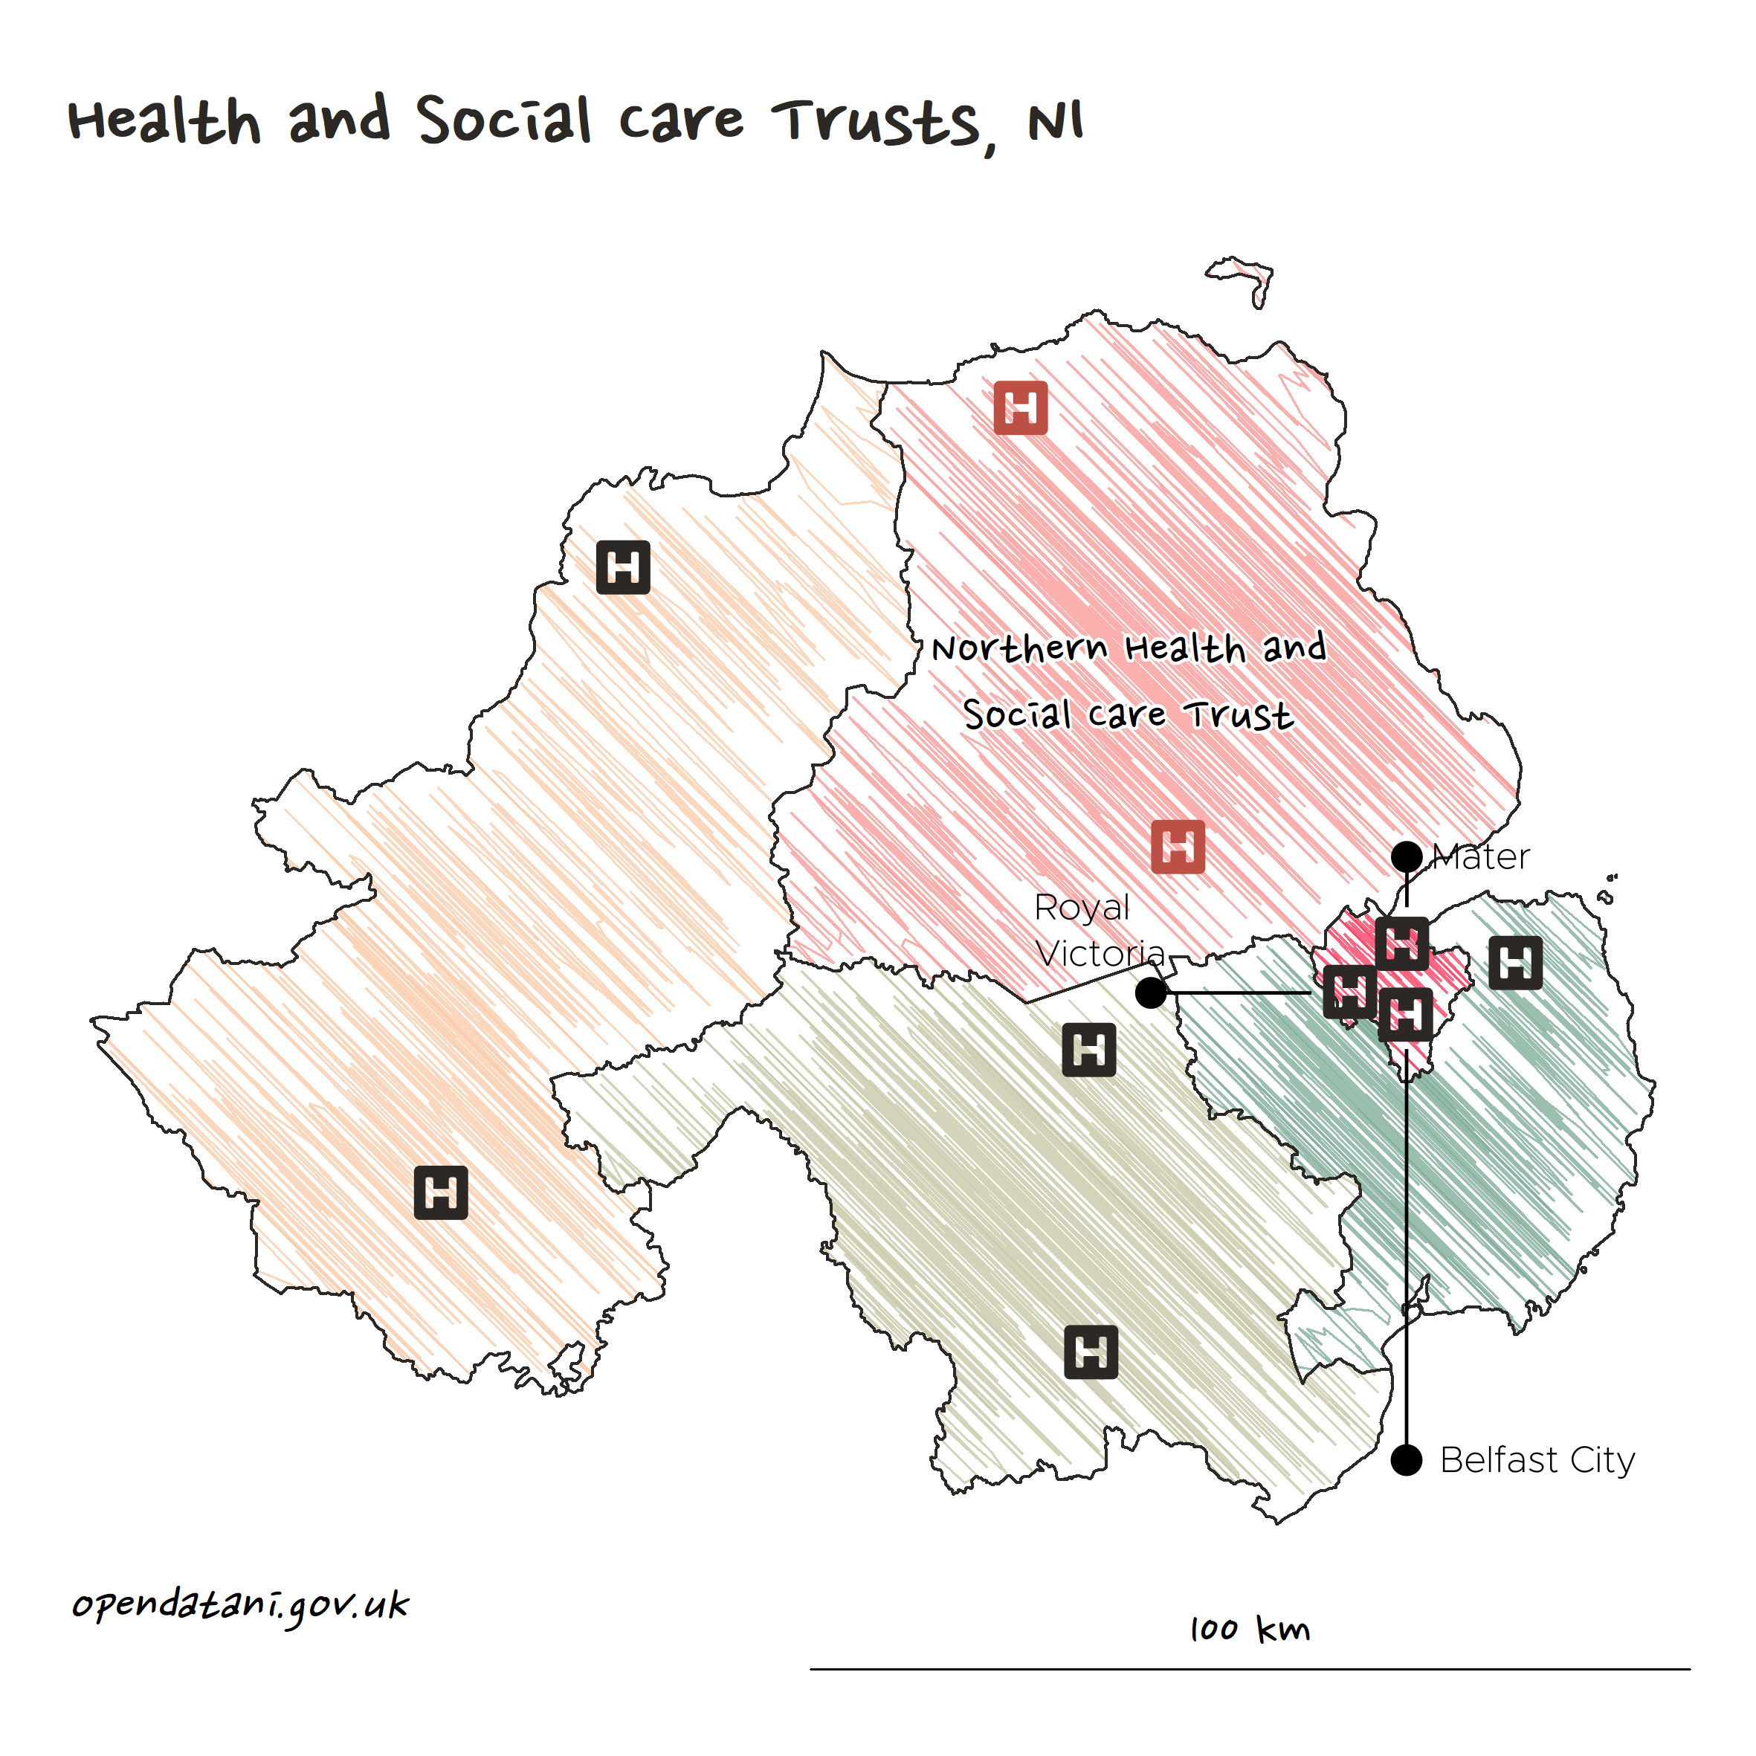

Slide 4
?
How effective is our mental health liaison service in reducing chance of admission from ED and inpatient length of stay
Notes:
Many potential outcomes – these were identified by the client

Slide 5
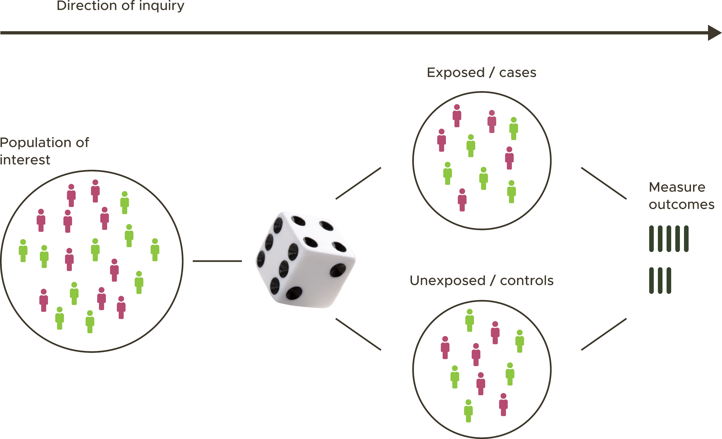
The gold standard

Slide 6
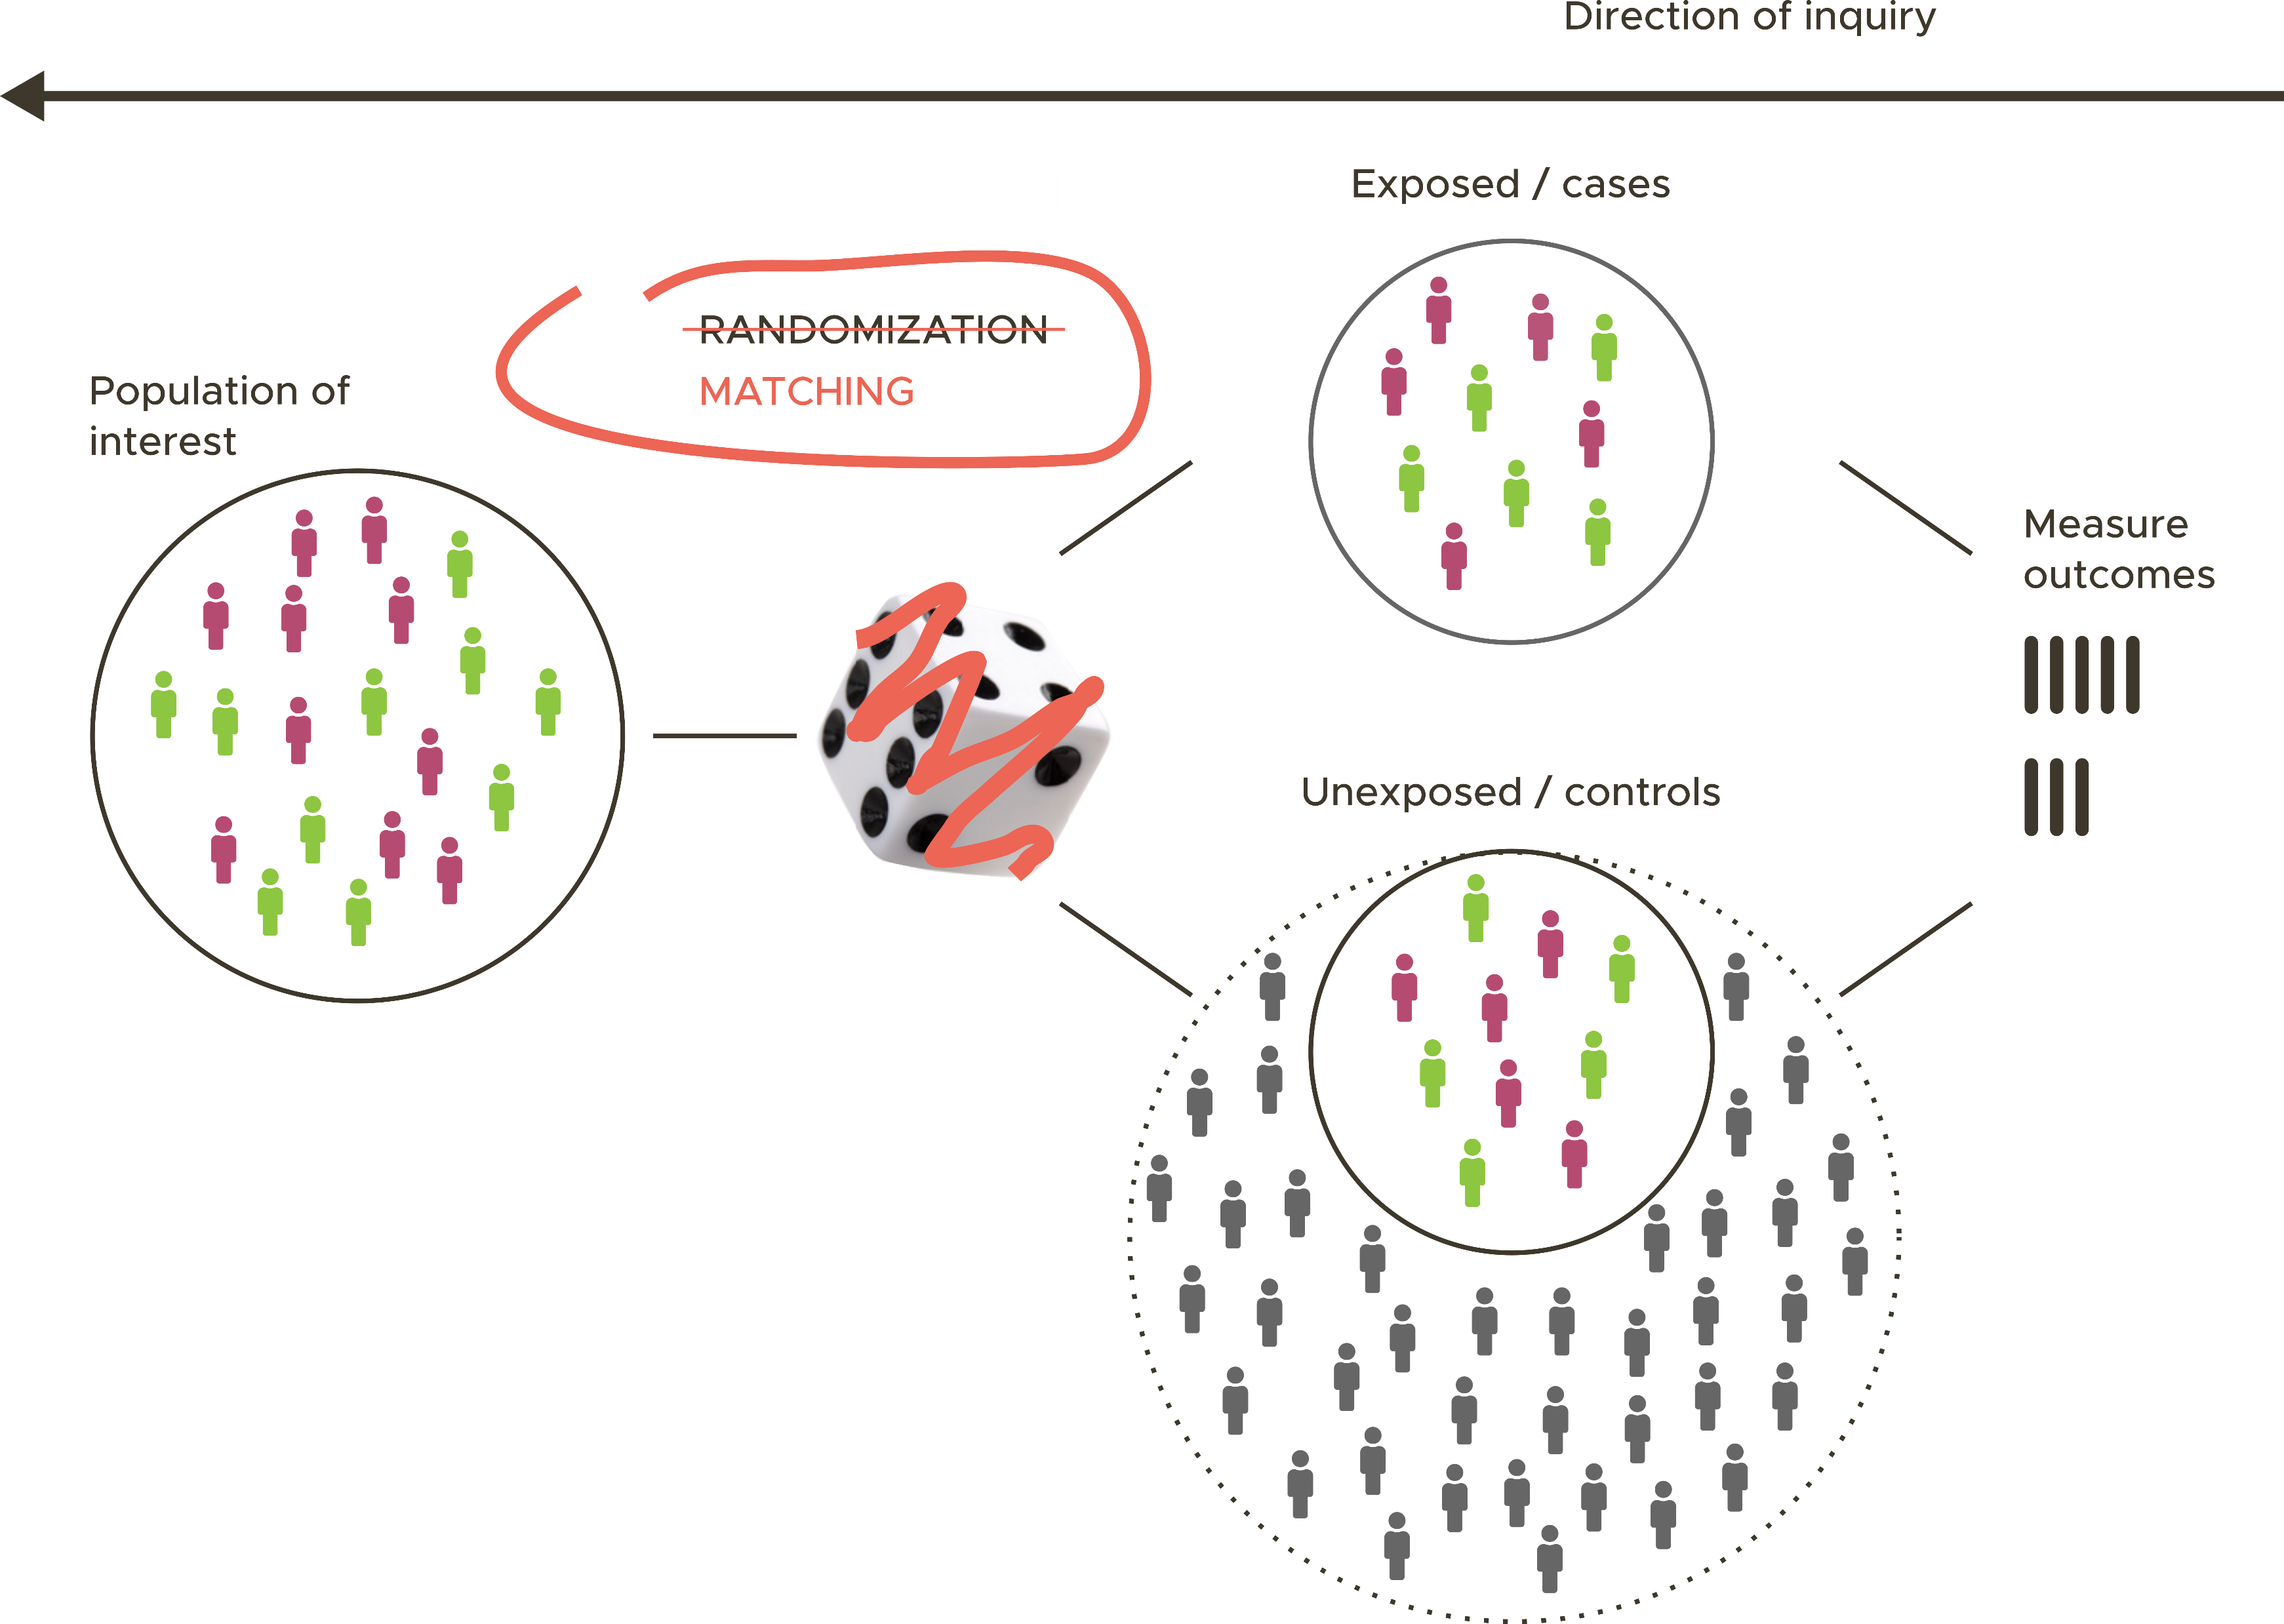
The Retrospective Matched Cohort Design

Slide 7
In a randomized experiment the treated and control groups will only differ at random.
Matching attempts to replicate a randomized experiment by obtaining treated and control groups with similar distributions (or ‘balance’) of all known variables.
Notes:
Known variables – observable & unobservable – requires judgement
1 no conflict with regression – can be used together
2 overlap between treated and control groups (covariates)
3 straightforward diagnostics (make researchers aware of quality of inferences - transparent)

Slide 8
Steps in matching methods
Select matching variables
Implement a matching method
Assess the quality of matching
Compare outcomes

Slide 9
Selecting matching variables
Patient characteristics
gender
age
deprivation
Attendance characteristics
incident type (self-harm, RTA, etc.)
attendance type (unplanned, planned)
arrival mode ¹
Presentation characteristics
triage category
diagnosis group ¹
Prior utilisation
All prior utilisation measures were calculated separately for both previous 28 days (4 weeks) and previous 180 days (6 months). Twelve measures in total.
count of ED attendances
count of ED attendances ending in admission
count of unplanned admissions
count of planned admissions
sum of unplanned hospital bed-days
sum of planned hospital bed-days
Environmental factors
time of day (day/night)
day of week
month of year
¹ Exact matching used.
Notes:
Identify all variables known to be related to both treatment assignment and the outcome.
Choose based on previous research and scientific understanding.
Err on the side of including more rather than fewer.

Slide 10

Variable transformation
Text mining – extracting meaning from unstructured textual information
Or what you need when you’re expecting
‘Diagnosis code = F41.1’
But receive instead
‘History of depression and under care of YPC. Self harm wounds to left wrist 1/7 ago … GP referral for further assessment of wounds’

Slide 11

Implementing a matching method
Genetic matching is a multivariate matching method that uses an evolutionary search algorithm to maximize the balance of observed covariates across matched treated and control units (Sekhon and Mebane, 1998).
Simulation studies have shown genetic matching outperforms alternative methods across a range of possible covariate distributions.

Slide 12
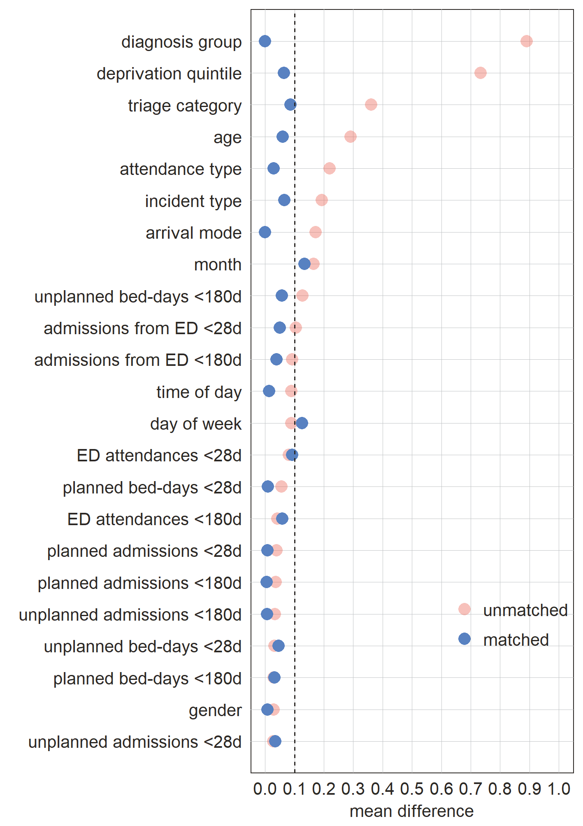
Assessing the quality of matching

Slide 13
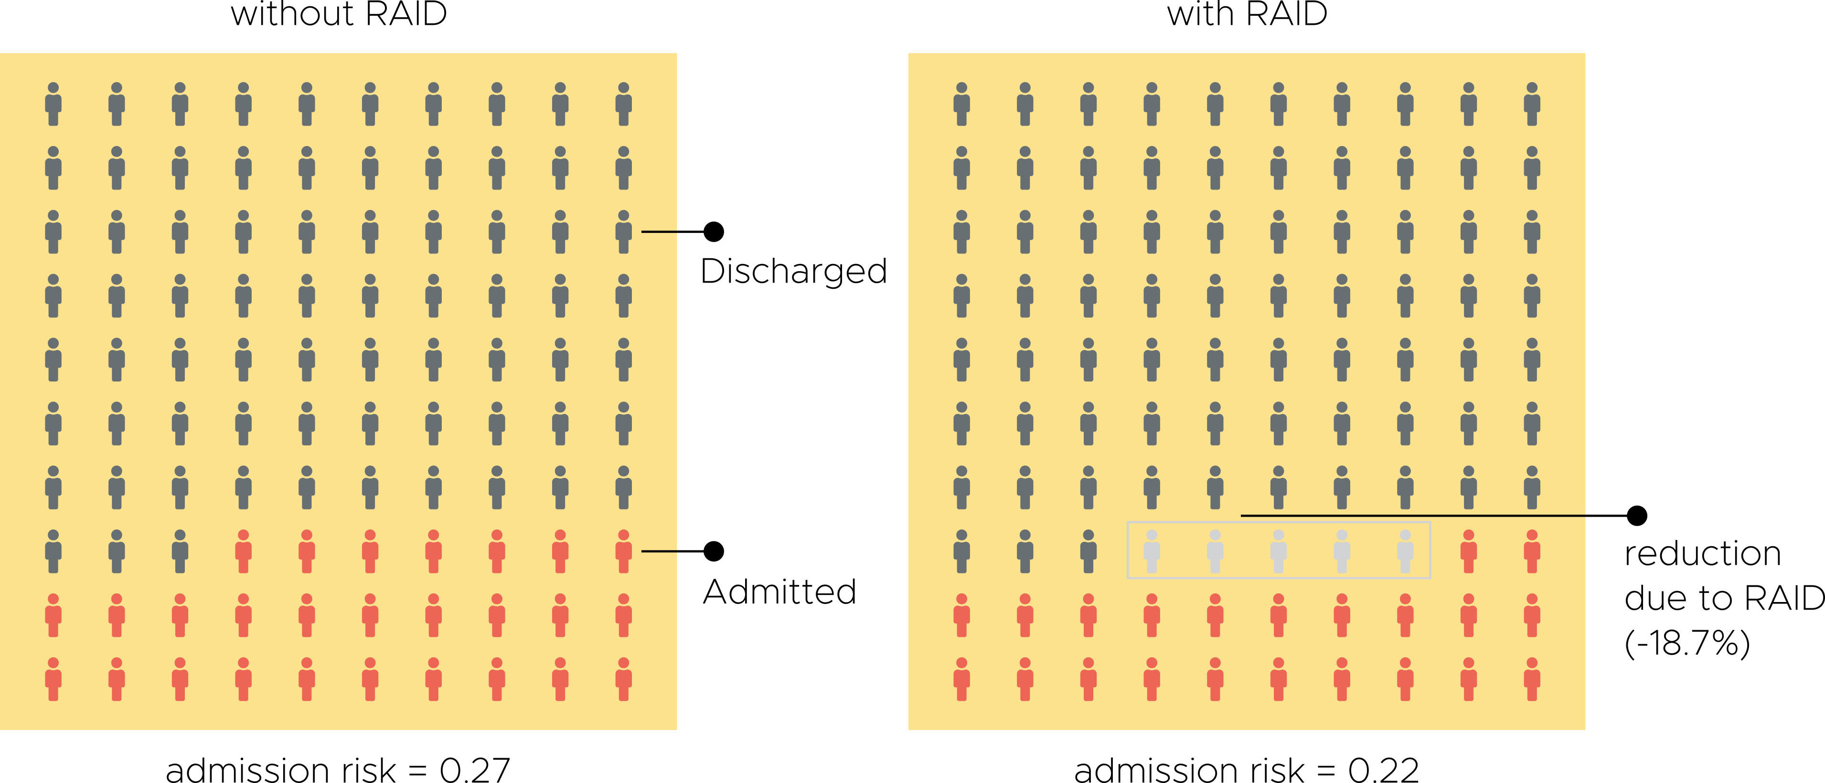
Comparing outcomes
Notes:
With regression adjustment
RR is close to .8

Slide 14
A copy of the evaluation report can be downloaded from our website https://bit.ly/37DEOHA
paulseamer@nhs.net
www.strategyunit.co.uk

